Slide 1


HI6040 (Artificial Intelligence and Machine Learning)
Dr. Farshid Keivanian

Slide 2
Welcome
Dear Students,
Welcome again to Week 2 of HI6040 – Artificial Intelligence and Machine Learning.
I hope you are beginning to settle into the trimester. This week, we take our first major step into practical applications of AI/ML using industry-standard tools such as Microsoft Azure ML Studio, Google Colab, and Anaconda-JupyterLab.
You’ll gain hands-on experience in setting up your machine learning development environments—both locally (on your device) and on the cloud—which is essential for completing your assessments and future professional tasks.
Please read the instructions below carefully and complete the steps during the tutorial or as directed by your tutor. This will help you stay on track and confidently build toward your upcoming tests and assignment.
Warm regards, Dr. Farshid Keivanian

Slide 3
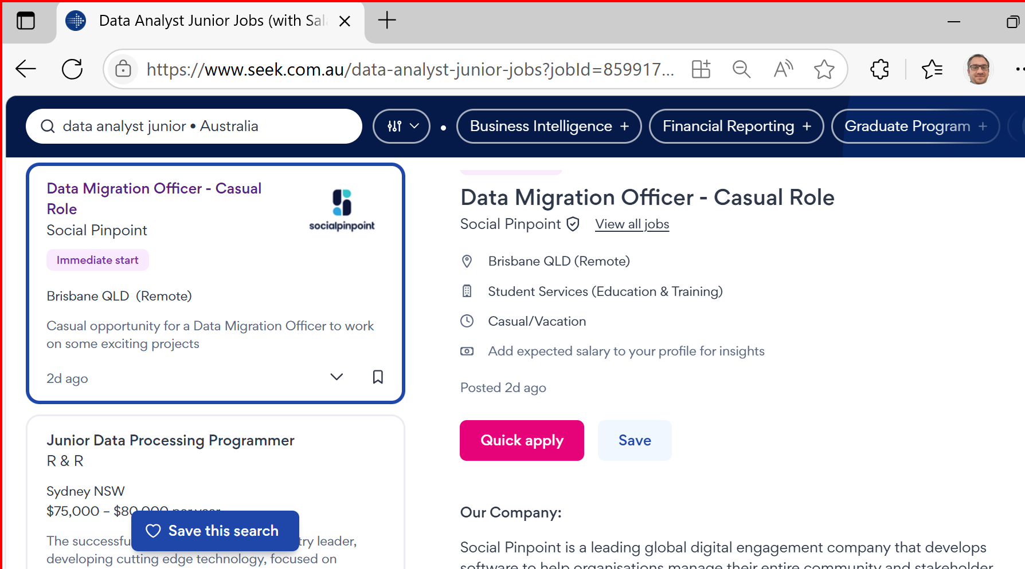
Career Opportunities & Certifications for ICT624 Graduates
Job Roles in Australia
Graduates of ICT624 – Advanced Data Analytics are well-positioned for roles such as:
Data Analyst: Interpret complex datasets to inform business decisions.

Slide 4
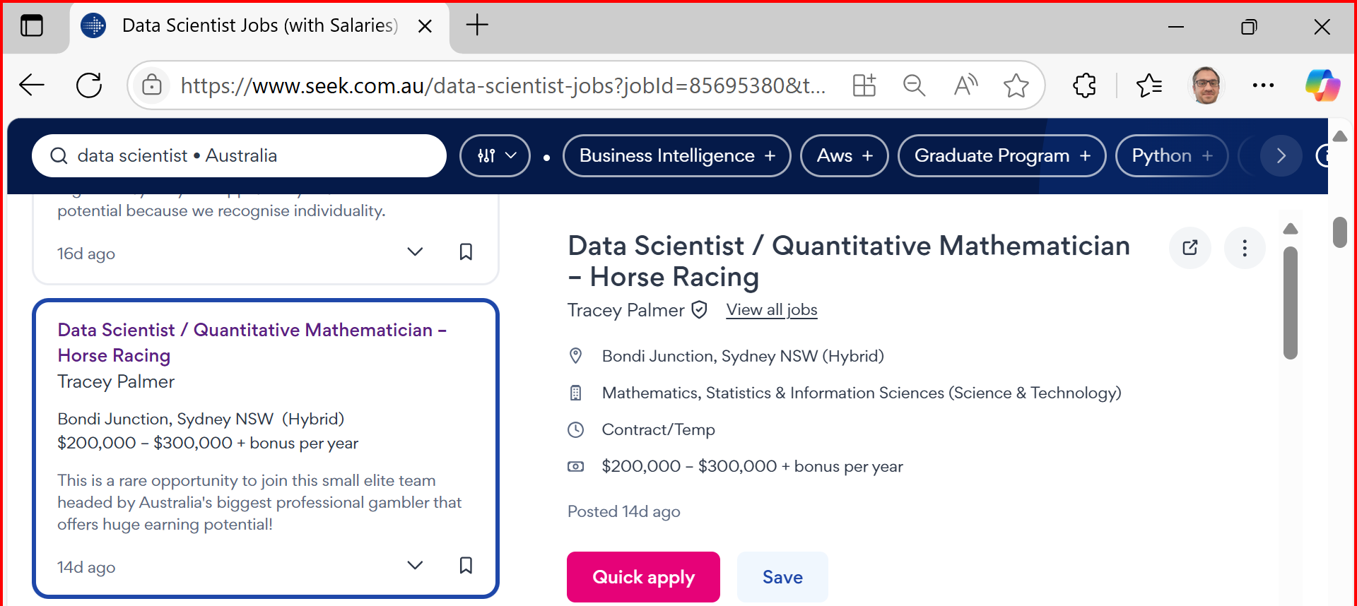
Career Opportunities & Certifications for ICT624 Graduates
Data Scientist Develop predictive models and uncover insights using ML & deep learning.

Slide 5
Career Opportunities & Certifications for ICT624 Graduates
Business Intelligence Analyst Translate analytics into strategic planning using BI tools.
Machine Learning Engineer Build and deploy scalable ML models in real-time systems.

Slide 6
Career Opportunities & Certifications for ICT624 Graduates
AI Solutions Consultant Advise on integrating AI into business operations.
Big Data Analyst Analyse large-scale datasets from cloud or distributed sources.
Advanced Analytics Consultant Design prescriptive models to solve industry-specific problems.

Slide 7
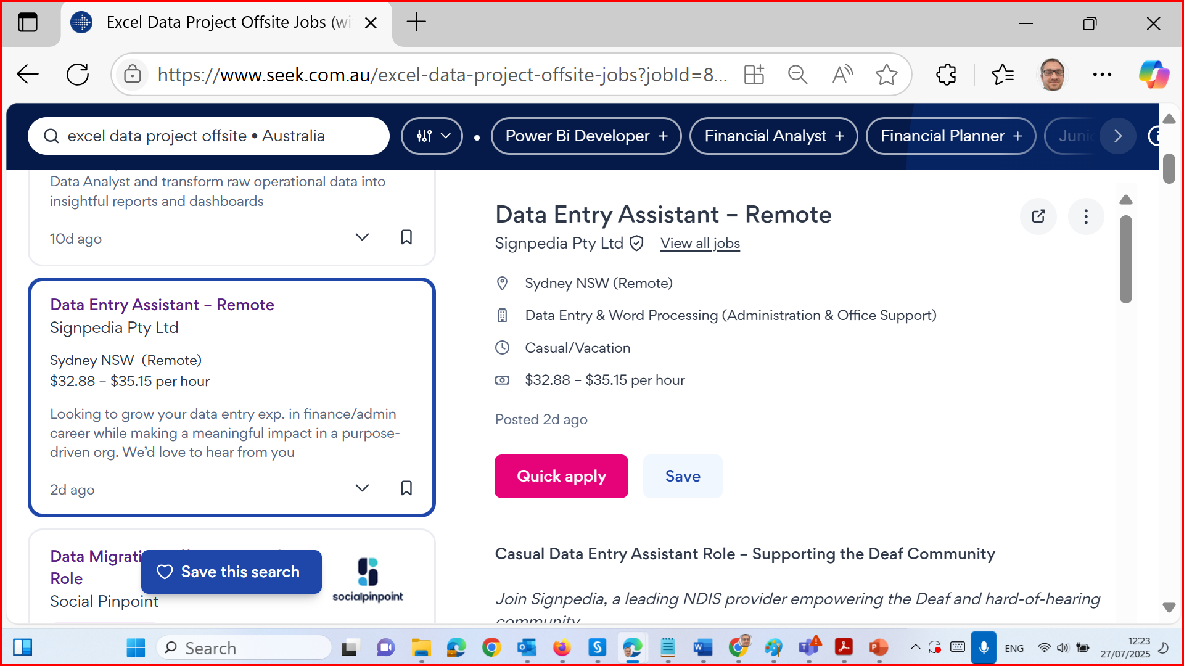
Career Opportunities & Certifications for ICT624 Graduates

Slide 8
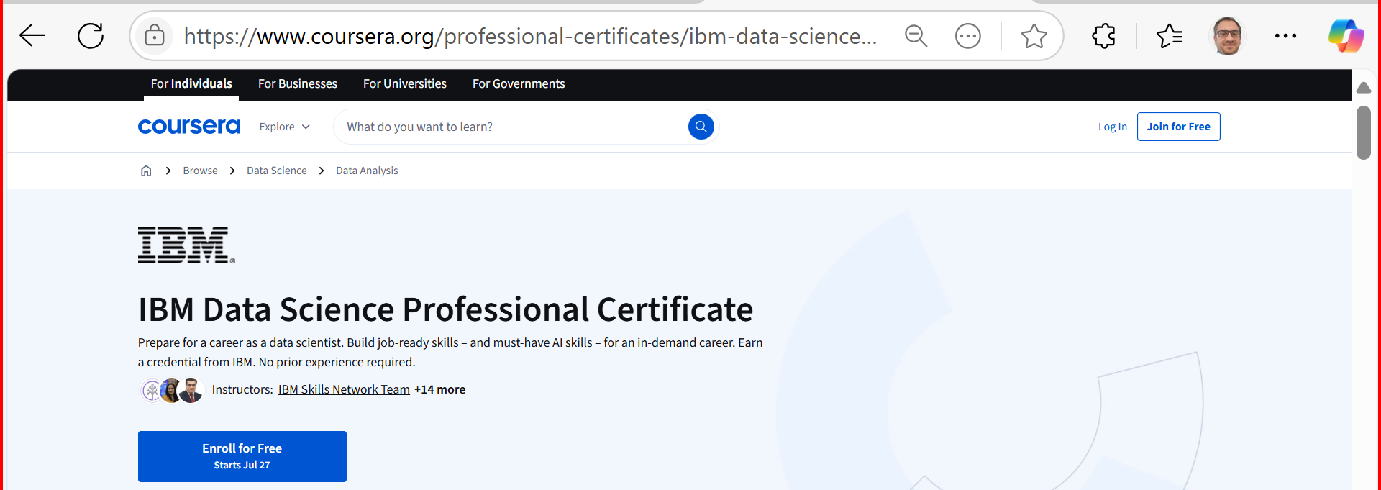
Career Opportunities & Certifications for ICT624 Graduates
Relevant Certifications (Optional/Recommended)
Enhance your employability with these recognised certifications:
IBM Data Science Professional Certificate (Coursera)

Slide 9
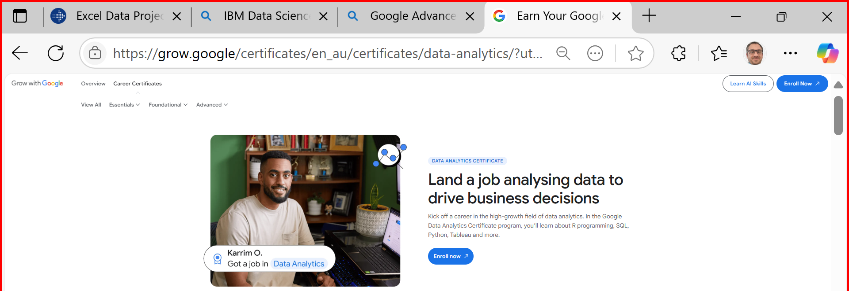
Career Opportunities & Certifications for ICT624 Graduates
Google Advanced Data Analytics Certificate

Slide 10
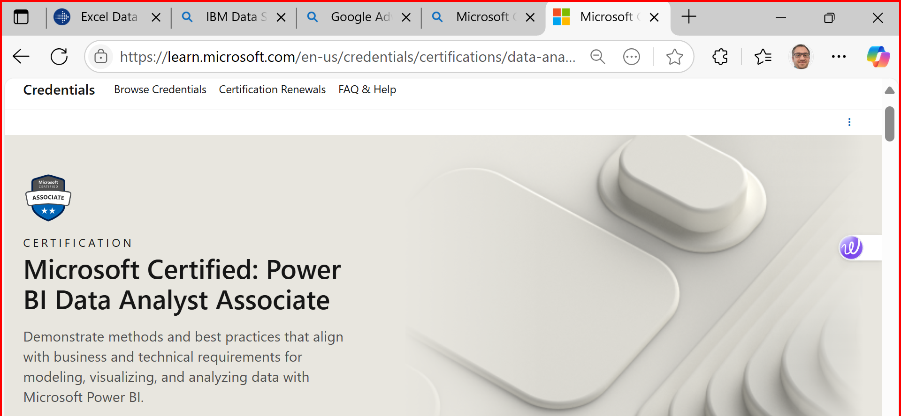
Career Opportunities & Certifications for ICT624 Graduates
Microsoft Certified: Data Analyst Associate (Power BI)

Slide 11
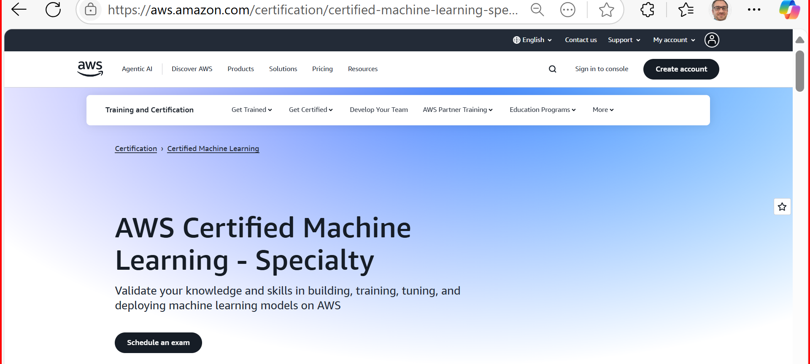
Career Opportunities & Certifications for ICT624 Graduates
AWS Certified Machine Learning – Specialty
SAS Certified Advanced Analytics Professional
Databricks Certified Data Engineer Associate

Slide 12
Unit Overview – HI6040: AI and ML
This unit introduces the foundational knowledge of Artificial Intelligence (AI) and Machine Learning (ML), focusing on:
Core ML algorithms and workflows
Application of AI in real-world decision-making
Use of tools like Azure ML, Python, and Colab
Understanding of ethical and social implications of AI
You’ll engage in guided labs, real-world case studies, and team collaboration activities that mirror professional environments.

Slide 13
Unit Expectations
Attend all tutorials and engage in practical activities
Join a group before the deadline for Group Facilitation (Weeks 5–11)
Complete the 2 online tests on time
Submit your individual assignment following all submission policies
Practice academic integrity and adhere to formatting and referencing requirements

Slide 14
Key Assessment Dates
Assessment | Due Date | Time | Notes
Test 1 (Online) | 19 August 2025 | 9:00 PM | 30 mins after launch
Test 2 (Online) | 30 September 2025 | 9:00 PM | 30 mins after launch
Group Facilitation | Weeks 5–11 (In Class) | In class | Join group before cutoff (TBA)
Individual Assignment | 8 October 2025 | 11:59 PM | Strict formatting and submission rules

Slide 15
What to Avoid
Submitting without a cover sheet or in the wrong format
Using screenshots or handwritten answers
Submitting via mobile/tablet or Blackboard App
Not joining a group before the deadline (will result in 20% penalty if solo)
Submitting from an overseas IP without clearance

Slide 16
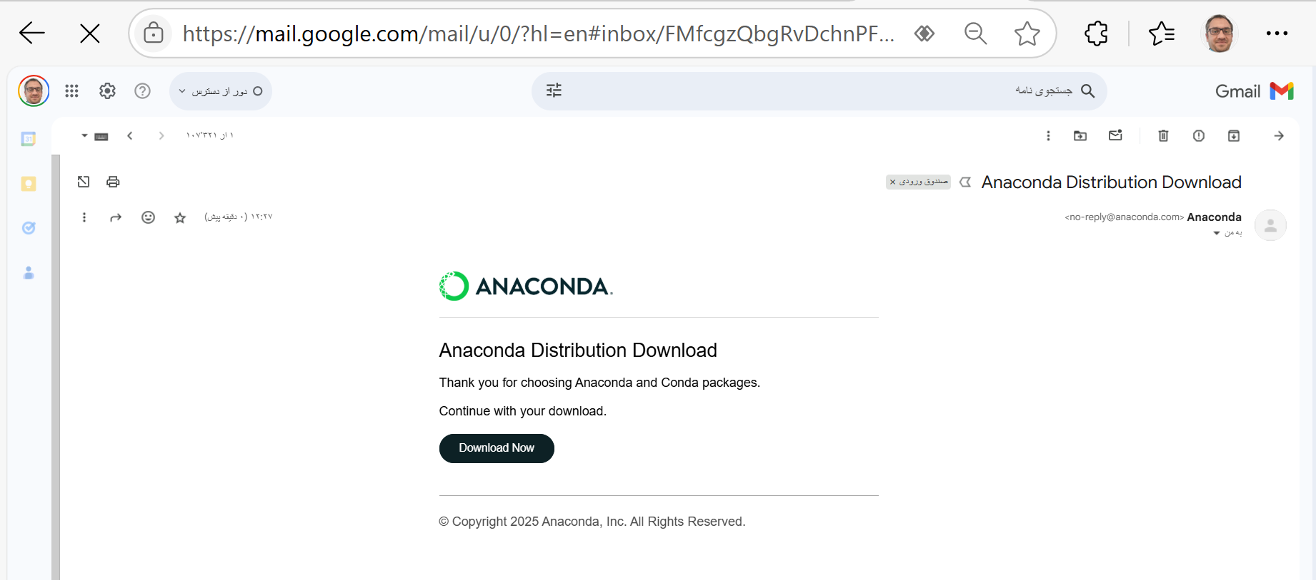
Week 2 Tutorial – Step-by-Step Instructions
Goal: Learn to use Azure ML Studio, Google Colab, and Anaconda for ML model development.
PART A: Local Setup Using Anaconda & JupyterLab
Download Anaconda Go to: https://www.anaconda.com/download Download the latest version for your OS.
Install Anaconda
Follow installation prompts.
Open Anaconda Navigator after installation.

Slide 17
Week 2 Tutorial – Step-by-Step Instructions
Goal: Learn to use Azure ML Studio, Google Colab, and Anaconda for ML model development.
Recommendation for HI6040
Use Anaconda if:
You're new to Python/ML
You want a plug-and-play setup with JupyterLab
Use VS Code if:
You're already comfortable with Python and want a more advanced, customizable development workflow
Use Google Colab if:
You want to access your code from anywhere at anytime using your Gmail.

Slide 18
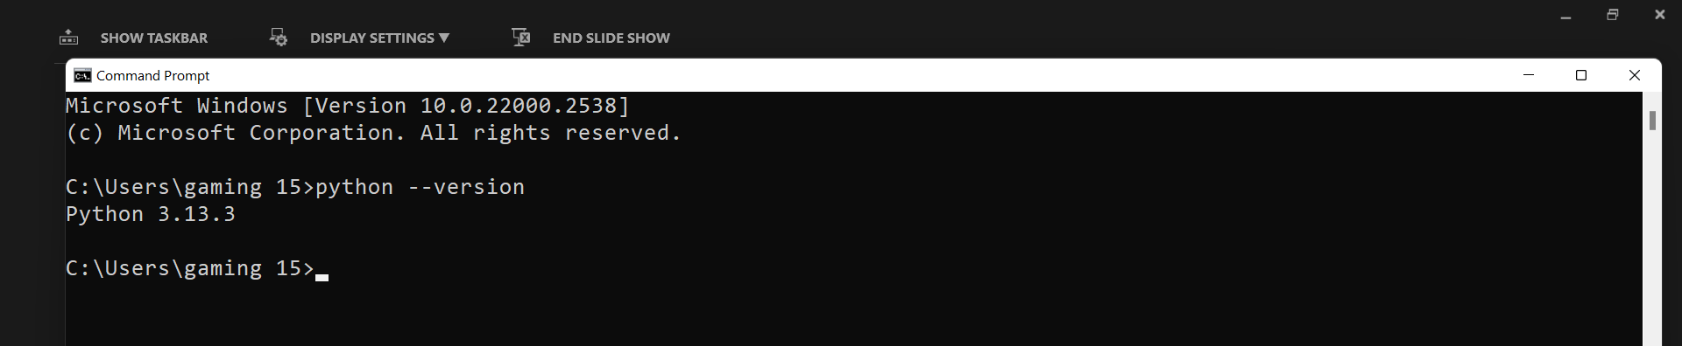
If you use Visual Studio Code
Test in terminal:
python --version
You have Jupyter support in VS Code Make sure you have the Jupyter extension installed
In VS Code → Extensions (Ctrl + Shift + X) → Search for "Jupyter" → Install
Make sure you have the required ML libraries installed, such as:
numpy
pandas
matplotlib
scikit-learn
seaborn (optional but useful)
jupyter
openml (optional for datasets)
Run this in terminal to install them all:
pip install numpy pandas matplotlib scikit-learn seaborn jupyter
You can run .ipynb notebooks in VS Code and execute Python code without issues.

Slide 19
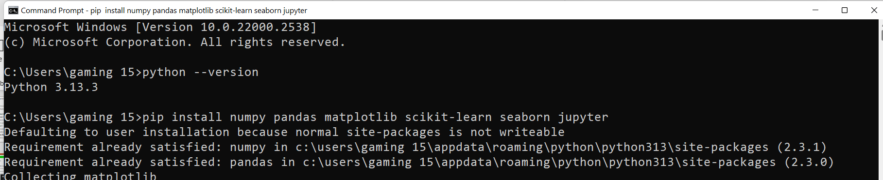
If you use Visual Studio Code
Test in terminal:
python --version
You have Jupyter support in VS Code Make sure you have the Jupyter extension installed
In VS Code → Extensions (Ctrl + Shift + X) → Search for "Jupyter" → Install
Make sure you have the required ML libraries installed, such as:
numpy
pandas
matplotlib
scikit-learn
seaborn (optional but useful)
jupyter
openml (optional for datasets)
Run this in terminal to install them all:
pip install numpy pandas matplotlib scikit-learn seaborn jupyter
You can run .ipynb notebooks in VS Code and execute Python code without issues.

Slide 20
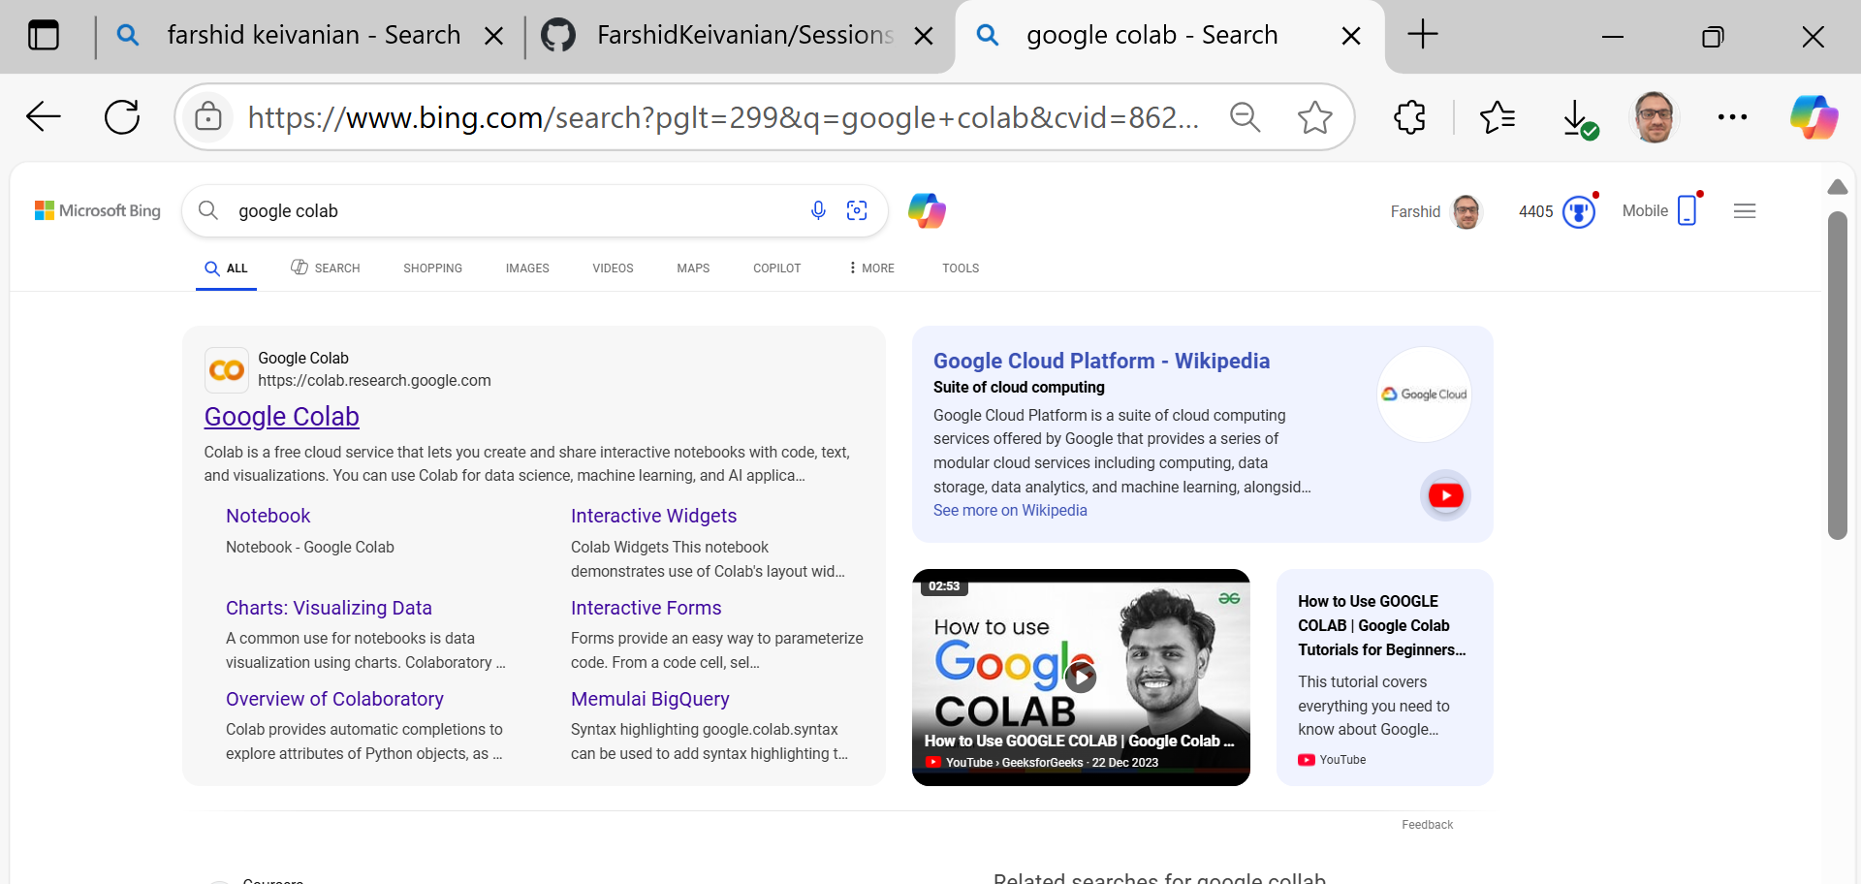
If you use Google Colab

Slide 21
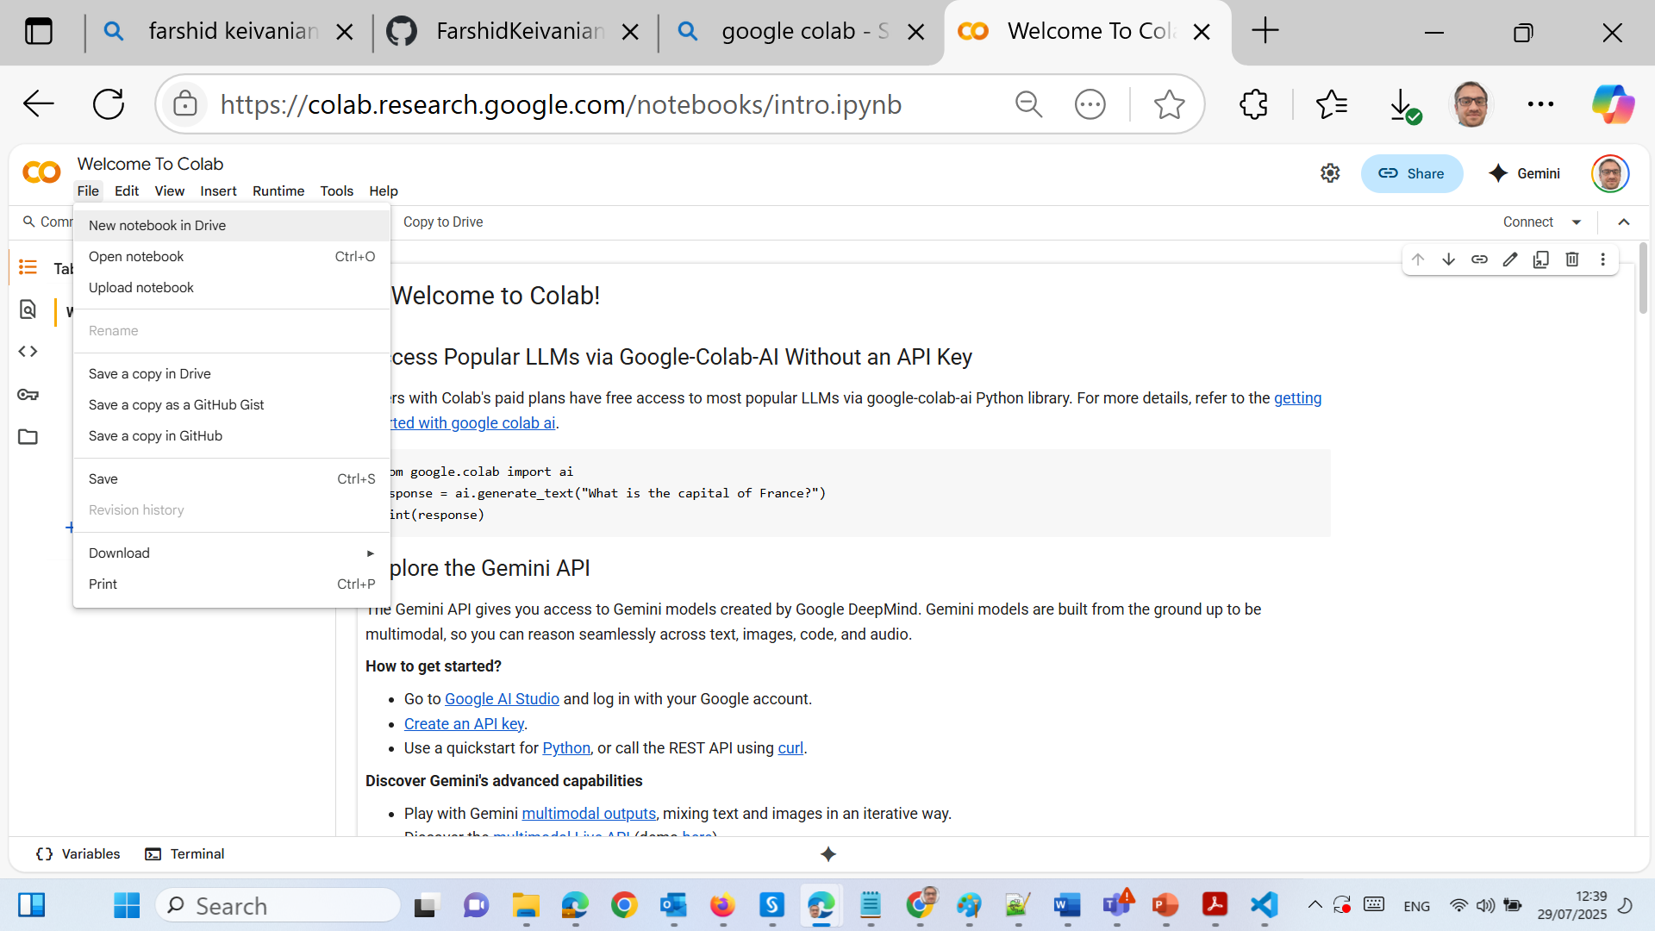
If you use Google Colab

Slide 22
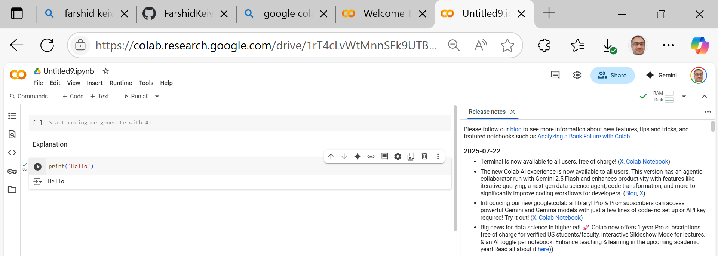
If you use Google Colab

Slide 23
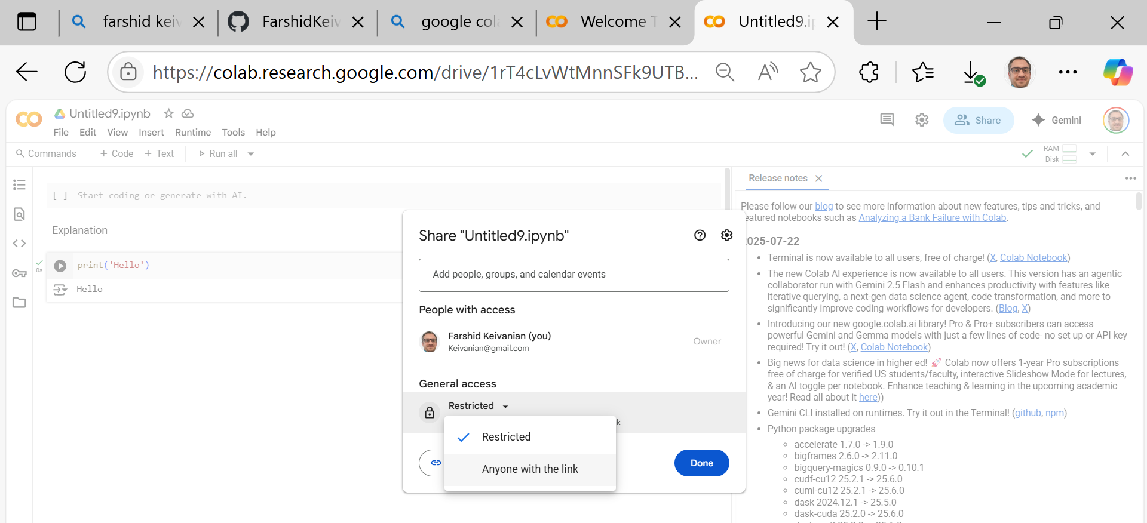
If you use Google Colab

Slide 24
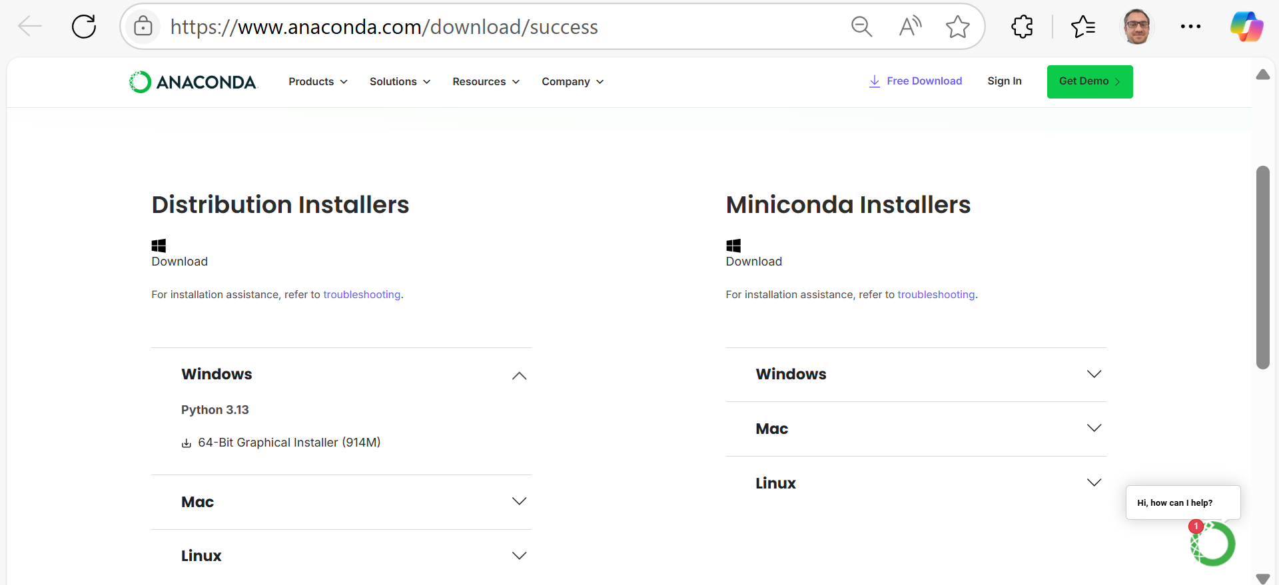
Week 2 Tutorial – Step-by-Step Instructions
If you use Anaconda – Follow these steps:
Windows/Mac/Linux
Distribution Installers → Windows / Mac / Linux (based on their OS)

Slide 25
Week 2 Tutorial – Step-by-Step Instructions
If you use Anaconda – Follow these steps:
Launch JupyterLab
From Anaconda Navigator, open JupyterLab.
It will open in a browser.
Create a new Python Notebook.
Write and Run Python Code
Use the grey code cells to write and run Python code.
Output appears below the code block.

Slide 26
Week 2 Tutorial – Step-by-Step Instructions
PART B: Cloud Setup with Google Colab
Log into Google Drive with your Gmail account.
Create or open a Colab Notebook Go to: https://colab.research.google.com Or open from Google Drive > New > More > Colab.
Write and run Python code Use the Runtime menu to run cells.

Slide 27
Week 2 Tutorial – Step-by-Step Instructions
PART C: Azure ML Studio Setup
Login via Skillable Labs Go to: https://msle.learnondemand.net
Sign in via Skillable Account
Username: your student email
Password: Holmes1234&

Slide 28
Week 2 Tutorial – Step-by-Step Instructions
Launch Your Lab
Click "Launch", then navigate to Resources.
View your login credentials and workspace access.
Explore Azure ML Studio
Visit: https://studio.azureml.net
Log in and create a workspace if required.
Explore three options: Automated ML, Designer, Notebooks.
For Week 2, click Designer and select Start Now.

Slide 29
Week 2 Tutorial – Step-by-Step Instructions
Navigate ML Designer
Use drag-and-drop tools for model creation.
Understand core elements: datasets, algorithms, evaluation blocks.

Slide 30
Learning Outcome by End of Week 2
Compare development environments: local (Anaconda/Jupyter) vs cloud (Colab, Azure ML)
Navigate Azure ML Studio Designer for low-code ML
Run Python code in Jupyter or Colab environments

Slide 31
To Do This Week
Attend the tutorial and complete the setup steps above
Create and save a basic Jupyter/Colab notebook with at least one ML-related Python example (e.g., linear regression with scikit-learn)
Begin exploring Azure ML Studio Designer and familiarize yourself with drag-and-drop interface

Slide 32
To Do This Week
If you face issues, bring your laptop to the tutorial session or contact the support tutor for assistance.
Let’s build a strong technical foundation this week!

Slide 33
Thank You
Need Help? Send an email or ask during the tutorial session.
FKeivanian@my.holmes.edu.au

